Slide 1
The man
Ziky Zhang

Slide 2
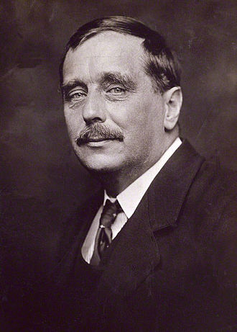
The Invisible Man
H.G. Wells (1866-1946)
British
Father of science fiction
most of the fictions are about “time travel”, “aliens attack”, or “anti-Utopia”

Slide 3

The Invisible Man
Settings:
England
1890’s.
entertain

Slide 4
The Invisible Man
A scientist called Griffin found out a way to become invisible
He break some laws and leave the town
He force some tramps and a guy call marvel help him out but caught by cops because marvel betray him
he runs away from cops and destroy the police station
Met his old friend dr. kemp and tell him what is he working on
Dr. kemp give him to the police
The police couldn’t keep him for so long, he run away and try to chase kemp
He got caught by the citizens and got killed

Slide 5
Figurative Language
Simile : "The poor soul's had an accident or an operation or somethin'…and they goggles! Why, he looked more like a divine' helmet than a human man!“(website)
Hyperbole: “a thief of ideas—he was always prying!”(website)

Slide 6
Imagery
Auditory : ”heard close to him the sound as of a man coughing, sneezing, and then swearing savagely to himself.”(website)

Slide 7
Works Cited
The website: www.gradesaver.com/the-invisible-man

